Slide 1
Comparison of redis with other caching mechanisms
Redis | Other Cache mechanism like Ehcache
In-memory data-structure store used as database,cache and message broker. | A simple java cache with only tiered data storage.
Implemented in C therefore the speed is better. | Developed in java,therefore relatively slow.
DB-Engines Ranking: Score/Rank-143.48/8 source:https://db-engines.com/en/system/Ehcache%3BMemcached%3BRedis | DB-Engines Ranking: Score/Rank-6.23/51
Supporting programming Languages:Almost Every high level programming language. | Supporting Programming Languages: Only Java.

Slide 2
Other Advantages of redis cache:
DB-Engines-Rankings specified properties:
# One of the most searched and system-mentioned cache management system.DB-Engine mines data from search engines like Google, Bing and and Yandex(Yandex is a russian search engine).
# Most no. of profile on professional networks mention this as a better in-memory data structure store which can be used as cache as well as database.
Most variety of data structures supported:
# Strings
# Sets
# Sorted Sets
#Hashes
#Lists…….all of them store value in form of contiguous sequence of chars.

Slide 3
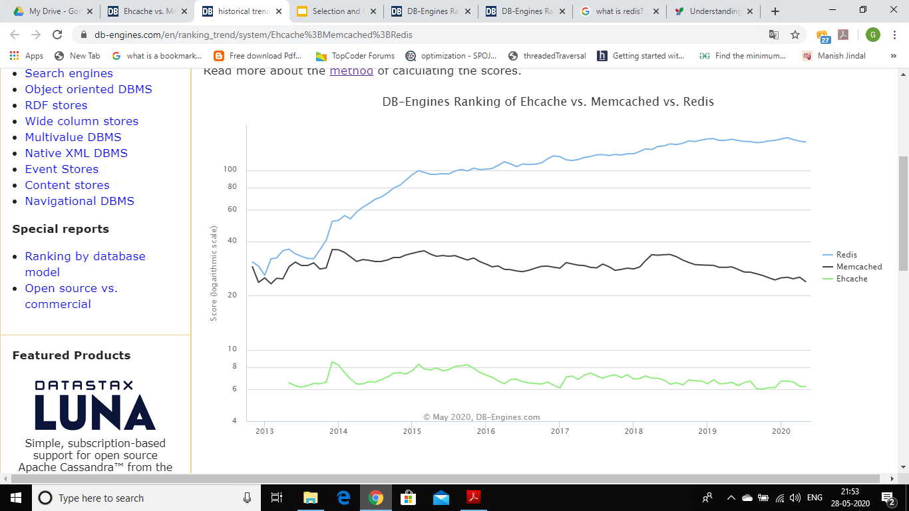

Slide 4
Some Limitations of redis and possible suggested solutions:
--------------------------------------------------------------------------------------------------
Redis is a NoSQL Database so there is no notion of ID and you have to rely on
KEY for data storage.
But so is the case of Cassandra and MongoDb and still we can use the KEY as ID or program the database to configure our own custom ID.
Redis is an in-memory database i.e. it stores data in RAM while doing query and updates in database, So there is a risk of data loss if server crashes or system turns off accidently.
But Redis provides us with two ways to configure it to achieve data persistency:
1.Dumping in-memory data to disk in compact format for each transaction (in form of log files).
2.Writing/Appending a file with every commands which alters the data on redis.

Slide 5
Installing redis in Ubuntu 18.04 :
$ sudo apt-get update
$ sudo apt-get install build-essential tcl
$ mkdir redis
$ cd redis
$ wget http://download.redis.io/releases/redis-6.0.3.tar.gz
$ tar xzf redis-6.0.3.tar.gz
$ cd redis-6.0.3
$ make
$ make test
$ src/redis-server
# after this, redis server will get activated on port 6379
# now open other terminal(don’t close previous terminal as it has server running)
#follow following commands in new terminal
$ cd redis
$ cd redis-6.0.3
$ src/redis-cli
#this will open redis client...Now you can communicate between server and client.
Documentation: https://redis.io/documentation

